Slide 1

Lesson 2 — Building Trust Quickly
The First 90 Days as a Leader

Slide 2
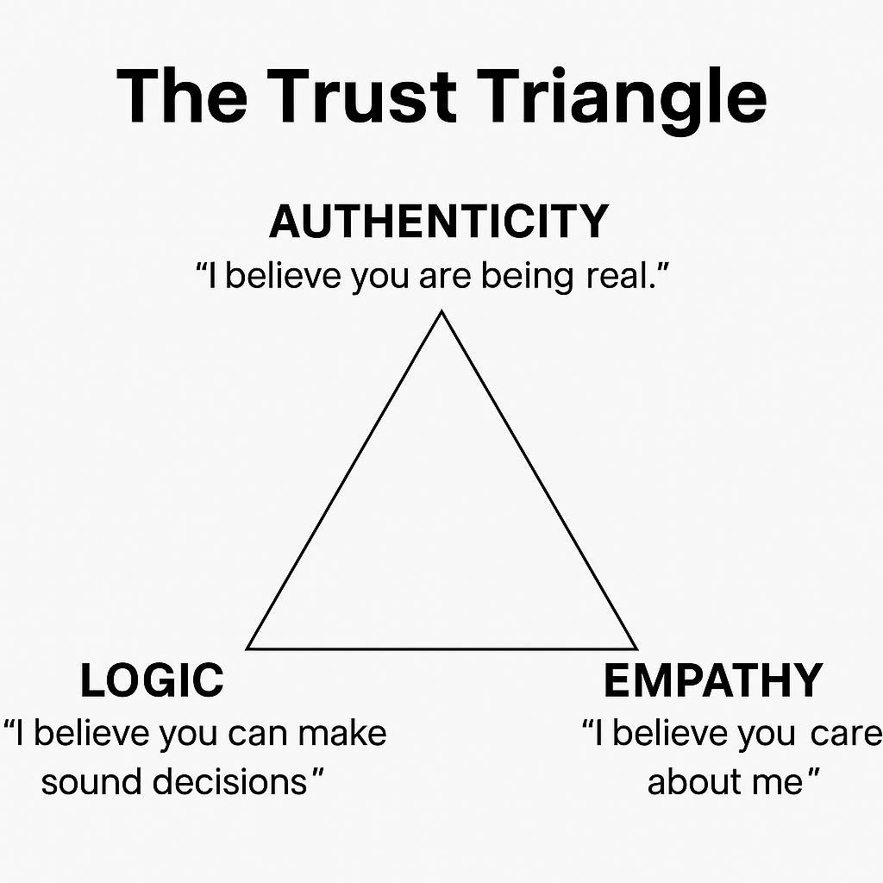
Trust Triangle
Famous Harvard leadership expert Frances Frei teaches that trust is built on 3 pillars. If one fails, trust falls. What do you think?

Slide 3
Why Listening First Matters
Listening before acting helps you:
  Understand the real context
  Build psychological safety
  Show humility and respect

Slide 4
Trust Builder 1: One-to-One Conversations
Ask open questions:
  What's working well?
  What could be improved?
  What do you need from me as your leader?

Slide 5
Trust Builder 2: Deliver One Small Promise
Follow-through builds credibility:
  Choose something small and achievable
  Act on it quickly
  Show reliability early

Slide 6
Trust Builder 3: Be Visible and Accessible
Build trust with consistent behaviour:
  Join team checkpoints
  Walk the floor
  Respond promptly
  Stay calm under pressure

Slide 7
This Week's Action Step
Schedule three one-to-one conversations:
  Listen more than you speak
  Ask open questions
  Look for themes and insights

Slide 8
Reflection
Consider this question:
  “What is one practical way I can build trust this week?”

